Slide 1

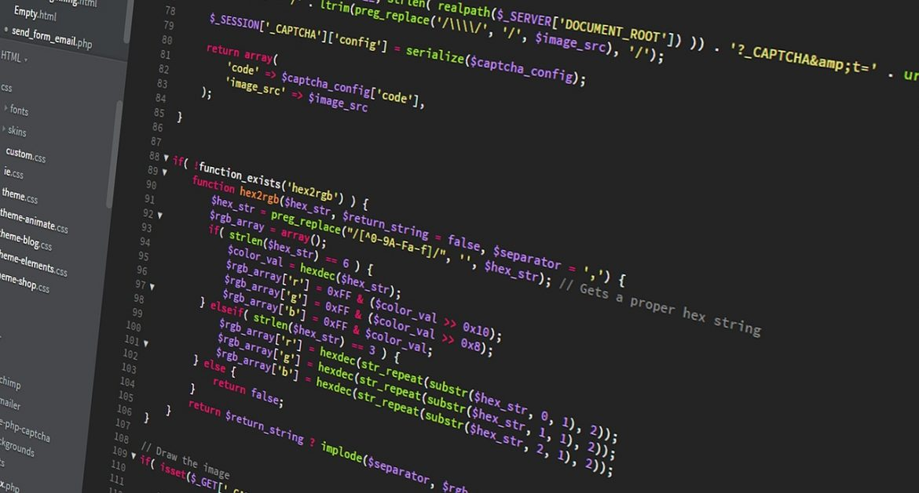
Software Development Concepts
Fundamental Concepts and Paradigms in the Software Engineering Profession
SoftUni Team
Technical Trainers
Software University
https://softuni.bg

Slide 2
Have a Question?
sli.do
#fund-common

Slide 3
Table of Contents
Front-End Development Concepts
Web Front-End and DOM
AJAX and RESTful APIs
Templating Engines
Routing and Routing Libraries
Libraries vs. Frameworks
UI Frameworks
Mobile Apps
3

Slide 4
Table of Contents (2)
Back-End Development Concepts
Databases and DBMS Systems
ORM Frameworks
The MVC Pattern
Virtualization, Cloud and Containers
Operating Systems and Linux Shell
Embedded Systems and IoT
4

Slide 5
Table of Contents (3)
Software Engineering Concepts
Software Development Lifecycle
Software Quality Assurance (QA)
Unit Testing
Source Control Systems
Project Trackers and Kanban Boards
5

Slide 6
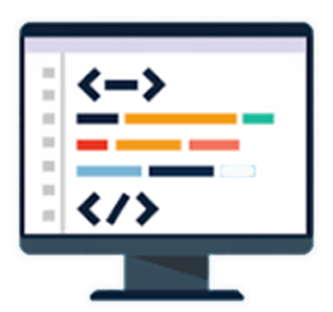
Front-End

Slide 7
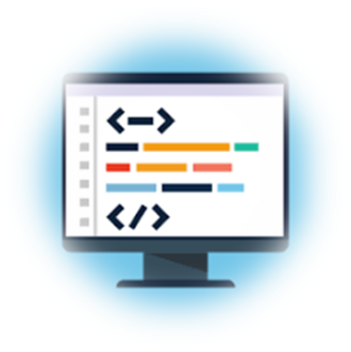
Web Front-End and DOM
Web front-end technologies (see https://platform.html5.org)
HTML, CSS, JavaScript, DOM, AJAX
JS front-end frameworks (e.g. React, Angular, Vue)
DOM (the Document Object Model)
DOM == a tree of UI and other elements
Documents in the Web browser are represented by a DOM tree
The DOM API allows changing the DOM from JS

Slide 8
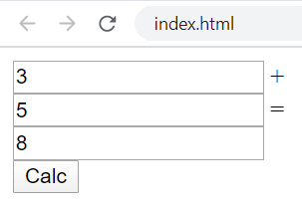
Using the DOM API – Example
<input type="text" id="firstNum" /> +
<input type="text" id="secondNum" /> =
<input type="text" id="sum" />
<button id="calc">Calc</button>
<script>
document.getElementById("calc").onclick = function() {
document.getElementById("sum").value =
Number(document.getElementById("firstNum").value) +
Number(document.getElementById("secondNum").value);
}
</script>

Slide 9
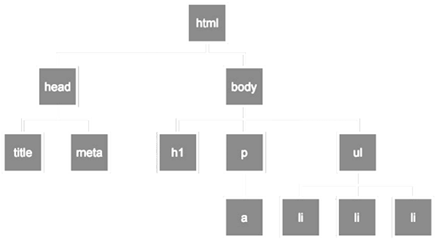
DOM Interaction
Live Demo
https://repl.it/@nakov/summator-js-dom

Slide 10

AJAX and RESTful APIs
AJAX is a technology for asynchronous execution of HTTP requests from client-side JavaScript
RESTful APIs are HTTP-based Web services
The HTTP methods GET, POST, PUT and DELETE retrieve, create, modify and delete data
let httpRequest = fetch('https://some-url…');
httpRequest.then(function(httpResponse) {
// Process the HTTP response here and update the DOM tree …
});

Slide 11
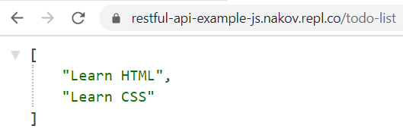
RESTful API Server – Example
const express = require('express');
const app = express();
app.use(require('cors')());
app.use(require('body-parser').json());
let todoList = ['Learn HTML', 'Learn CSS'];
app.get('/todo-list', (req, res) => {
res.json(todoList);
});
app.post('/todo-list', (req, res) => {
todoList.push(req.body.todoText);
res.sendStatus(200);
});
app.listen(8080);

Slide 12
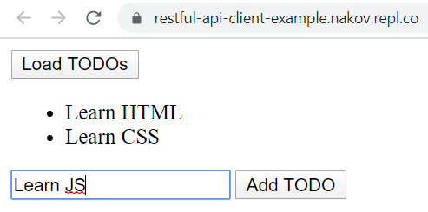
RESTful API Client – Example
<button id="load">Load TODOs</button>
<ul id="todo-list"></ul>
<input type="text" id="todo" />
<button id="add">Add TODO</button>
<script>
const apiUrl = 'https://restful-api-js.nakov.repl.co/todo-list';
document.getElementById("load").onclick = loadTodos;
document.getElementById("add").onclick = addTodo;
async function loadTodos() { … }
async function addTodo() { … }
</script>

Slide 13
RESTful API Client – Example (2)
async function loadTodos() {
let response = await fetch(apiUrl);
let todos = await response.json();
document.getElementById("todo-list").innerHTML = "";
todos.forEach(function(todo) {
let li = document.createElement("li");
li.appendChild(document.createTextNode(todo));
document.getElementById("todo-list").appendChild(li);
});
}

Slide 14
RESTful API Client – Example (3)
async function addTodo() {
let todoText = document.getElementById("todo").value;
let response = await fetch(apiUrl, {
method: 'post',
headers: { 'Content-Type': 'application/json' },
body: JSON.stringify({todoText})
});
loadTodos();
}

Slide 15
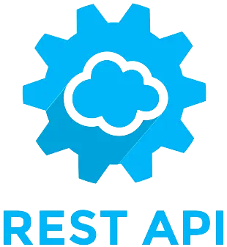
AJAX and REST
Live Demo
https://repl.it/@nakov/RESTful-API-js
https://repl.it/@nakov/RESTful-API-client-example

Slide 16
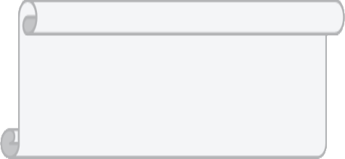
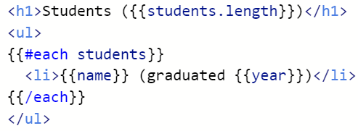

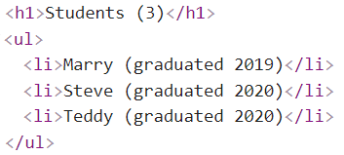


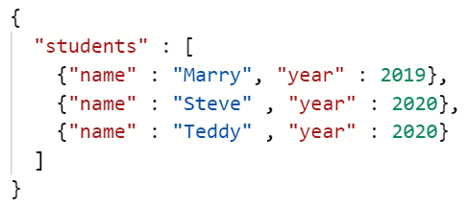

Templating Engines
Templating engines render data as HTML through a template
template
HTML
data
templating
engine

Slide 17
Templating Engines Example – Template
Sample template for rendering list of students (using the handlebars engine syntax):
<script id="studentsTpl" type="text/x-handlebars-template">
<h1>Students ({{students.length}})</h1>
<ul>
{{#each students}}
<li>{{name}} (graduated {{year}})</li>
{{/each}}
</ul>
</script>

Slide 18
Templating Engines Example – JSON Data
Sample data for rendering (list of students)
students.json
{
"students" : [
{"name" : "Marry", "year" : 2019},
{"name" : "Steve" , "year" : 2020},
{"name" : "Teddy" , "year" : 2020}
]
}

Slide 19
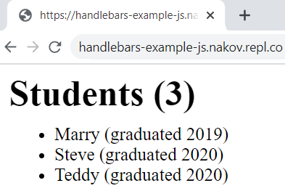
Templating Engines Example – Rendering
Rendering the students using Handlebars templating engine:
<script src="https://cdnjs.cloudflare.com/ajax/libs/handlebars.js/4.7.6/handlebars.min.js"></script>
<script>
async function loadStudents() {
let response = await fetch('students.json');
let students = await response.json();
let studentsTemplate = Handlebars.compile(
document.getElementById("studentsTpl").innerHTML);
document.body.innerHTML = studentsTemplate(students);
}
loadStudents();
</script>

Slide 20
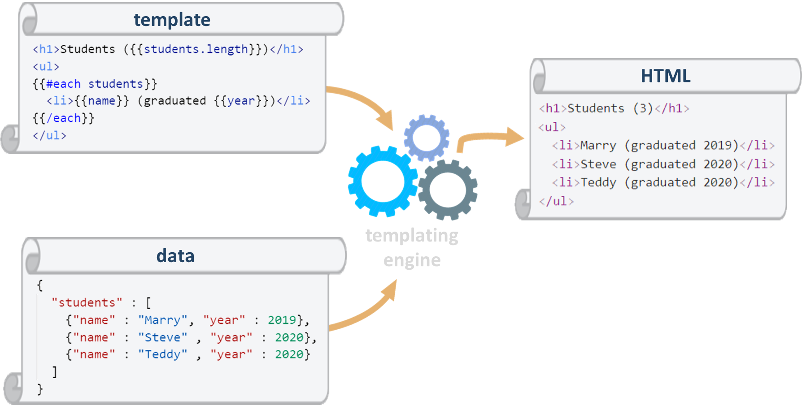
Rendering UI with a Templating Engine
Live Demo
https://repl.it/@nakov/Handlebars-example-JS

Slide 21
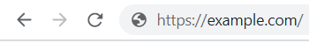
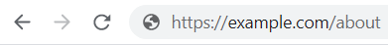
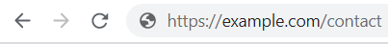
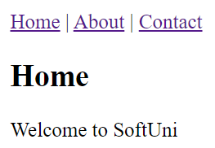
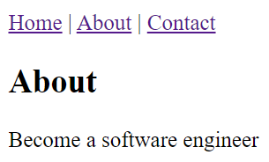
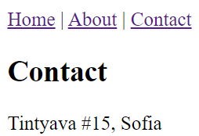
Routing and Routing Libraries
Routing is about switching between different UI views, based on the changes of the current URL (holding the route)
Routing libraries switch the view by URL like this:

Slide 22
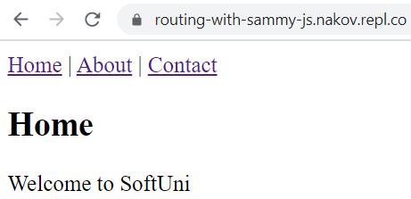
Routing with Sammy.js – Example
Routing with Sammy.js:
$.sammy(function() {
this.get('/', function() {
showView('home');
});
this.get('/#/about', function() {
showView('about');
});
this.get('/#/contact', function() {
showView('contact');
});
}).run();

Slide 23
Routing with Sammy.js – Example
<header>
<a href="/">Home</a> |
<a href="/#/about">About</a> |
<a href="/#/contact">Contact</a>
</header>
<section id='home'><h1>Home</h1>Welcome to SoftUni</section>
<section id='about'><h1>About</h1>Become a software engineer</section>
<section id='contact'><h1>Contact</h1>Tintyava #15, Sofia</section>
<script src="https://unpkg.com/jquery@3.5.0/dist/jquery.js"></script>
<script src="https://unpkg.com/sammy@0.7.6/lib/sammy.js"></script>

Slide 24
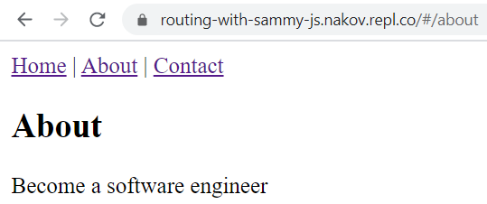
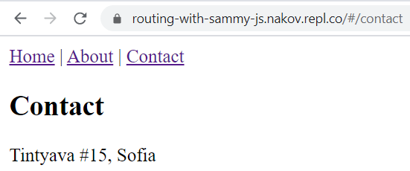
Routing with Sammy.js – Example (2)
<script>
$.sammy(function() {
this.get('/', function() { showView('home') });
this.get('/#/about', function() { showView('about') });
this.get('/#/contact', function() { showView('contact') });
}).run();
function showView(viewId) {
$('section').hide();
$('#' + viewId).show();
}
</script>

Slide 25
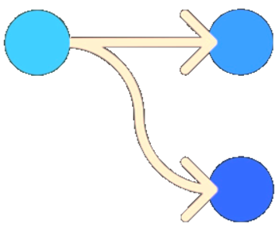
Navigation with Routing Library
Live Demo
https://repl.it/@nakov/routing-with-sammy-js

Slide 26
User Interface and Front-End Frameworks
Graphical User Interface (GUI) systems provide forms, dialogs and UI controls for desktop and mobile apps
Examples: Windows Forms, XAML, WPF, Qt
Mobile UI toolkits / frameworks provide UI controls and structure for mobile apps
Examples: Apple UIKit, Android UI, Flutter
Web front-end frameworks and UI libraries provide user interface elements and structure for Web apps
Examples of UI frameworks: Angular, React, Vue.js, Meteor
Examples of UI libraries: Kendo UI, Sencha Ext JS, Onsen UI

Slide 27
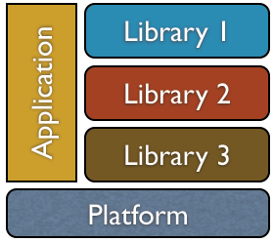
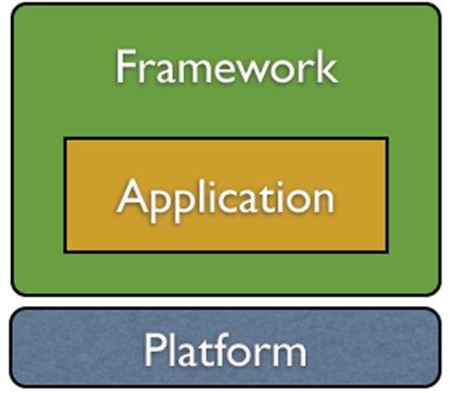
Libraries vs. Frameworks
Libraries provide components / functionality / UI controls for integration into existing apps
The app controls the library components
Examples: UI control library, Excel reader
Development frameworks are foundations, which developers extend to build an app
The framework controls the app lifecycle and your code plugs in it (inversion of control – IoC)
Examples: MVC framework, ORM framework

Slide 28
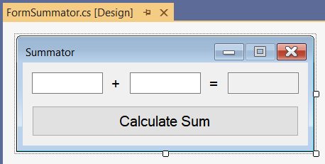
Windows Forms – Example
Windows Forms is GUI framework for .NET developers
Provides programming model and rich UI control library
public partial class FormSummator : Form
{
private TextBox textBox1;
private Label labelPlus;
private Label labelEqual;
private TextBox textBox2;
private TextBox textBoxSum;
private Button buttonCalc;
}

Slide 29
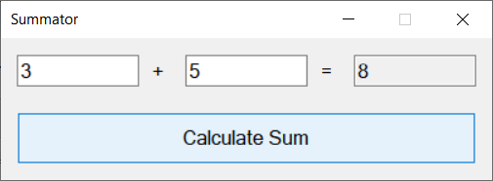
Windows Forms – Example (2)
public partial class FormSummator
{
private void buttonCalc_Click(object sender, EventArgs e)
{
decimal firstNum = decimal.Parse(this.textBox1.Text);
decimal secondNum = decimal.Parse(this.textBox2.Text);
decimal sum = firstNum + secondNum;
this.textBoxSum.Text = sum.ToString();
}
}

Slide 30
Windows Forms
Live Demo

Slide 31
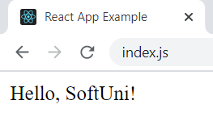
React
React is a powerful JavaScript library from Facebook for building Web UI using HTML, CSS and JS
The UI is built from JSX components, which combine HTML + JS
class HelloMessage extends React.Component {
render() {
return (<div>Hello, {this.props.name}!</div>);
}
}
ReactDOM.render(<HelloMessage name="SoftUni" />,
document.getElementById('root'));

Slide 32
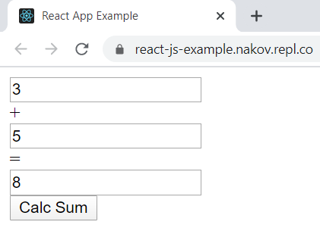
Simple React App – Example
import React, { useState } from 'react';
function Summator() {
const [num1, setNum1] = useState();
const [num2, setNum2] = useState();
const [sum, setSum] = useState();
return (
<div className="Summator">
<input type='text' value={num1} onChange={e => setNum1(e.target.value)} /> +
<input type='text' value={num2} onChange={e => setNum2(e.target.value)} /> =
<input type='text' value={sum} readOnly='true' />
<button onClick={() => setSum( Number(num1) + Number(num2))}>Calc Sum</button>
</div>
);
}

Slide 33

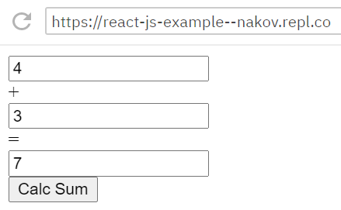
React
Live Demo
https://repl.it/@nakov/react-js-example

Slide 34

Mobile Apps – Technologies
Two major mobile app platforms: Android and iOS
Mobile app development technologies
Android: Java / Kotlin + Android SDK + Android Studio
iOS: Swift (or Objective-C) + iOS SDK + Xcode + Mac
Hybrid mobile apps: JS + HTML5 + WebView (e.g. Cordova)
Native JS mobile apps: JavaScript + native UI
Examples: React Native, NativeScript
Others: Xamarin (C#), Flutter (Dart)
34

Slide 35
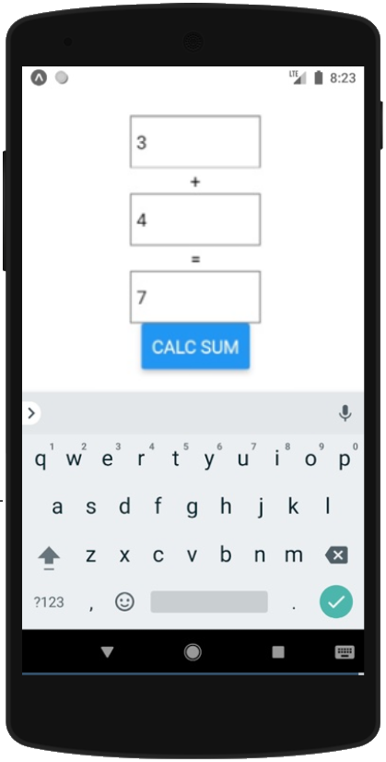
React Native Mobile App – Example
import React, { useState } from 'react';
import {View, TextInput, Text, Button } from 'react-native';
export default function Summator() {
const [num1, setNum1] = useState();
const [num2, setNum2] = useState();
const [sum, setSum] = useState();
return (<View style={{…}}>
<TextInput style={{…}} value={num1}
onChangeText={text => setNum1(text)} /><Text>+</Text>
<TextInput style={{…}} value={num2}
onChangeText={text => setNum2(text)} /><Text>=</Text>
<TextInput style={{…}} value={sum} editable={false} />
<Button title="Calc Sum" onPress={() => setSum("" + (Number(num1) + Number(num2)))} />
</View>);
}

Slide 36
React Native App
Live Demo
https://snack.expo.io/@nakov/summator-react-native

Slide 37

Back-End

Slide 38

Back-End Technologies
Back-end technologies are about server-side programming
Data management technologies and ORM frameworks
Backend Web frameworks and MVC frameworks
REST API frameworks, reactive APIs, other services and APIs
Microservices, containers and cloud
Back-end developers work on the server-side
They deal with the business logic, data processing, data storage, APIs

Slide 39


Databases
Databases hold and manage data in the back-end systems
Relational databases (RDBMS)
Hold data in tables + relationships
Use the SQL language to query / modify data
Examples: MySQL, PostgreSQL, Web SQL in HTML5
NoSQL databases
Hold collections of documents or key-value pairs
Examples: MongoDB, IndexedDB in HTML5

Slide 40
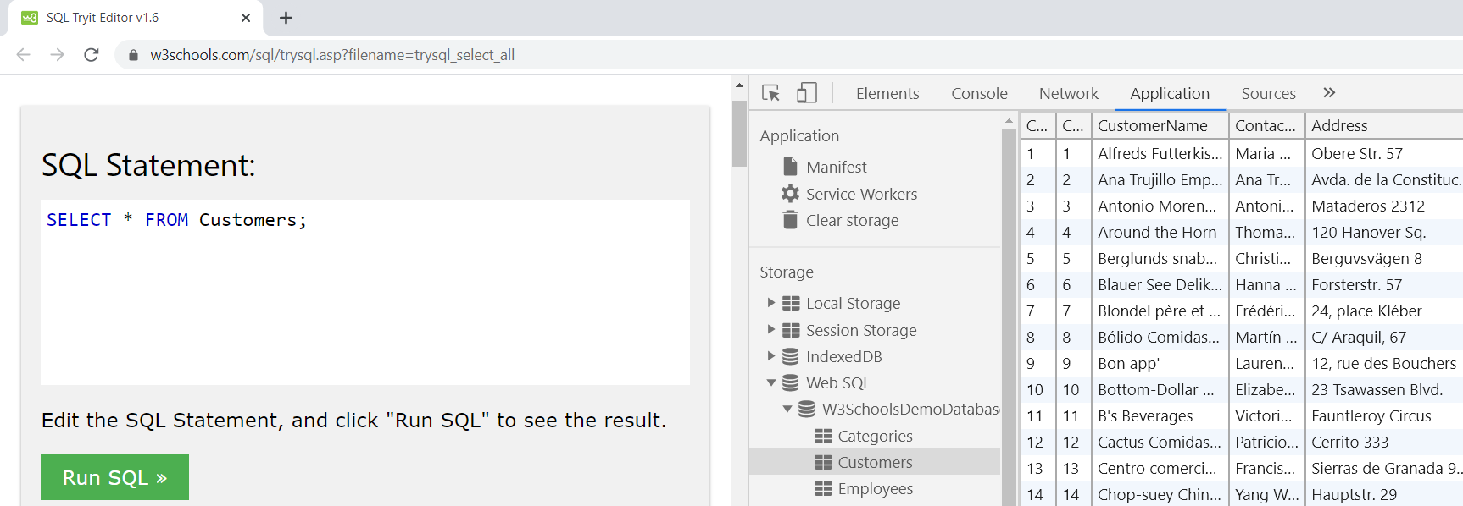
Web SQL – Example
Web SQL is a relational database, embedded the Web browsers
It is fully functional RDBMS system, runs at the client-side

Slide 41
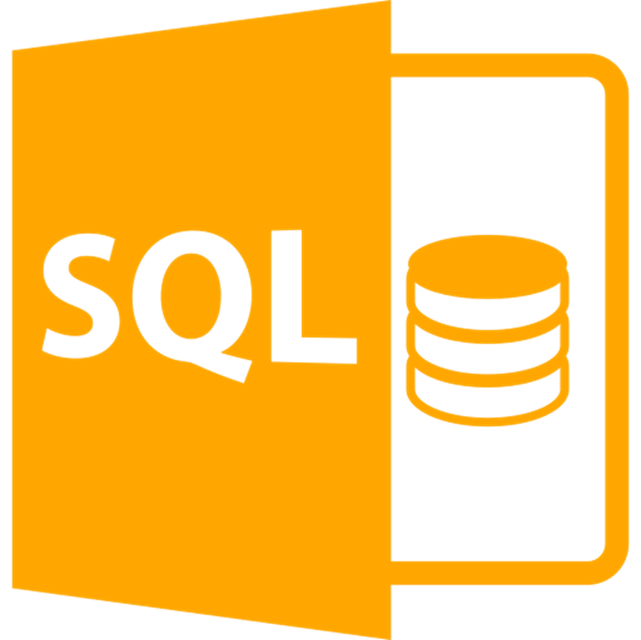
Web SQL
Live Demo
https://w3schools.com/sql/

Slide 42
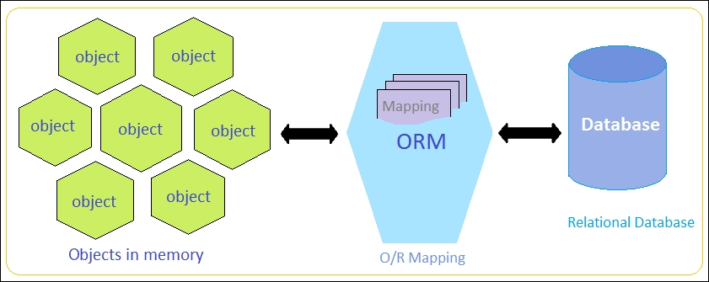
ORM Frameworks
ORM frameworks (object-relational mapping) allow persisting objects in relational database (by mapping classes to tables)
E.g. store JS objects in MySQL database
Popular ORM frameworks:
Entity Framework (C#)
Hibernate (Java)
Sequelize (JavaScript)
SQLAlchemy (Python)

Slide 43
ORM Example – JayData ORM for Web SQL
<script src="https://unpkg.com/jaydata@1.5.10/public/jaydata.js"></script>
<script>
let Task = $data.Entity.extend("Task", {
Id: { type: "int", key: true, computed: true },
Task: { type: String, required: true, maxLength: 200 },
DueDate: { type: Date },
Completed: { type: Boolean }
});
let TodoDatabase = $data.EntityContext.extend("TodoDatabase", {
Tasks: { type: $data.EntitySet, elementType: "Task" }
});
let todoDB = new TodoDatabase({
provider: 'webSql', databaseName: 'TodoDB'
});

Slide 44
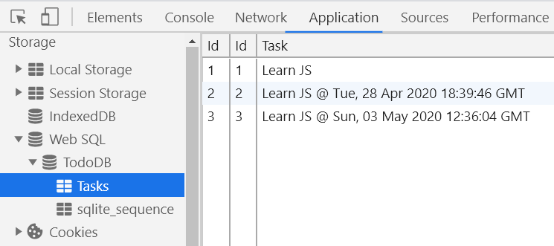
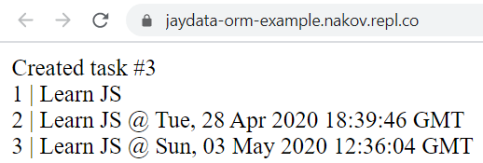
ORM Example – JayData ORM for Web SQL (2)
todoDB.onReady(async function() {
// Create a new task in the table 'Tasks'
let newTask = todoDB.Tasks.add(
{ Task: 'Learn JS @ ' + new Date().toUTCString() });
await todoDB.saveChanges();
document.write("Created task #" + newTask.Id);
// List all tasks
let tasks = await todoDB.Tasks.toArray();
tasks.forEach(task => document.write( `<div>${task.Id} | ${task.Task}</div>`)
);
});
</script>

Slide 45

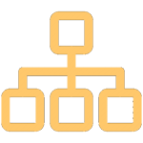

JayData ORM for Web SQL
Live Demo
https://repl.it/@nakov/jaydata-orm-example

Slide 46
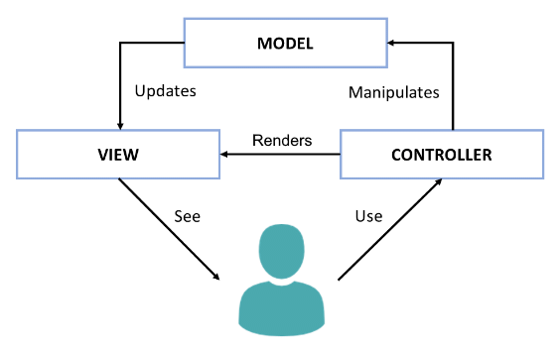
The Model-View-Controller (MVC) Pattern
The Model-View-Controller (MVC) pattern
Controller
Handles user actions
Updates the model
Renders the view (UI)
Model
Holds app data
View
Displays the UI, based on the model data

Slide 47
Web MVC Frameworks
Web MVC frameworks are used build Web applications
Controllers handle HTTP GET / POST and render a view
Views display HTML + CSS, based on the models
Models hold app data for views, prepared by controllers
Examples of Web MVC frameworks:
ASP.NET MVC (C#), Spring MVC (Java), Express (JS), Django (Python), Laravel (PHP), Ruby on Rails (Ruby), Revel (Go), …

Slide 48
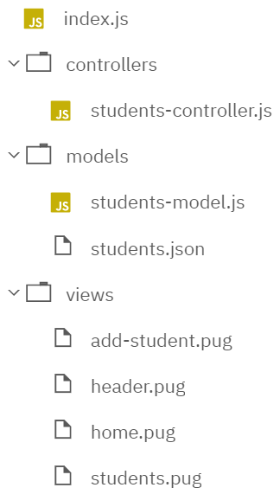
MVC Web App – Example
const express = require('express');
const app = express();
app.set('view engine', 'pug');
app.use(require('body-parser')
.urlencoded({extended:true}));
const studentsController =
require("./controllers/students");
studentsController.setup(app);
app.listen(8080);
index.js

Slide 49
MVC Web App – Example: Controllers
let studentsModel =
require("../models/students");
function setup(app) {
app.get('/', function(req, res) {
let model = {
title: "MVC Example",
msg: "Students Registry",
students: studentsModel
};
res.render('home', model);
});
students-controller.js
app.get("/students",
function(req, res) {
let model = {
title: "Students",
students: studentsModel
};
res.render(
'students', model);
}
);
…
Render the UI template views/students.pug
Render the UI template views/home.pug

Slide 50
MVC Web App – Example: Models
const fs = require('fs');
module.exports = JSON.parse(
fs.readFileSync('./models/students.json'));
students-model.js
[
{"name": "Marry", "email": "marry@gmail.com"},
{"name": "Steve" , "email": "steve@yahoo.com"},
{"name": "Teddy" , "email": "teddy@mail.ru"}
]
students.json

Slide 51
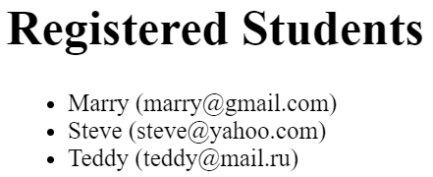

MVC Web App – Example: Views
include header.pug
h1 Registered Students
ul
each s in students
li #{s.name} (#{s.email})
students.pug
html
head
title=title
body
a(href='/') Home
span |
a(href='/students') View Students
header.pug

Slide 52

MVC Frameworks
Live Demo
https://repl.it/@nakov/MVC-express-pug-example

Slide 53
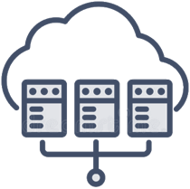
Virtualization and Cloud
Virtualization == running a virtual machine (VM) / virtual environment inside a physical hardware system
E.g. run Android VM or Linux inside a Windows host
Storage, memory, networking, desktops can also be virtual
Cloud == computing resources, virtual machines, storage, platforms and software instances, available on demand
IaaS (infrastructure as a service) – virtual machines on demand
PaaS (platform as a service) – app deployment environments
SaaS (software as a service) – software instances, e.g. Office 365

Slide 54

Containers and Docker
Container image == software, packaged with its dependencies, designed to run in a virtual environment (like Docker)
E.g. WordPress instance (Linux + PHP + Apache + WordPress)
Simplified installation, configuration and deployment
Docker is the most popular containerization platform
Runs containers from local image or downloaded from the Docker Hub online repository
Open-source, runs on Linux, Windows, Mac

Slide 55
Docker – Example
Install Docker on your local computer
Or use the Docker online playground: https://labs.play-with-docker.com (with a free Docker Hub registration)
Download and run a Docker image in a new container:
Open the exposed URL: http://localhost:8080
View currently running Docker containers
docker run -d -p:8080:80 dockersamples/static-site
docker ps

Slide 56

Play with Docker
Live Demo
https://labs.play-with-docker.com

Slide 57
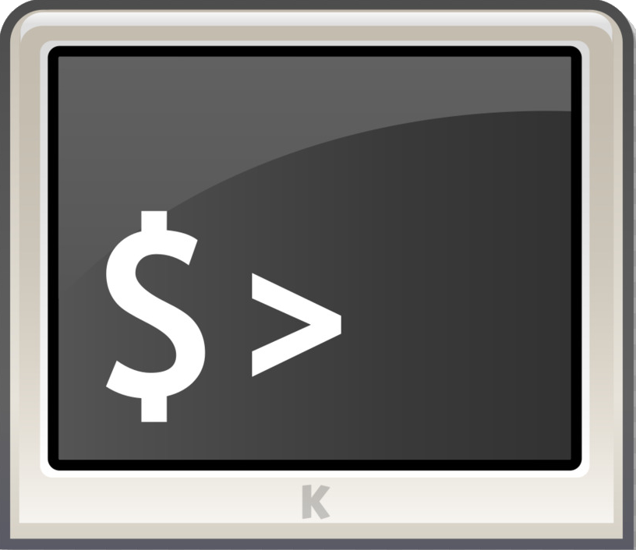
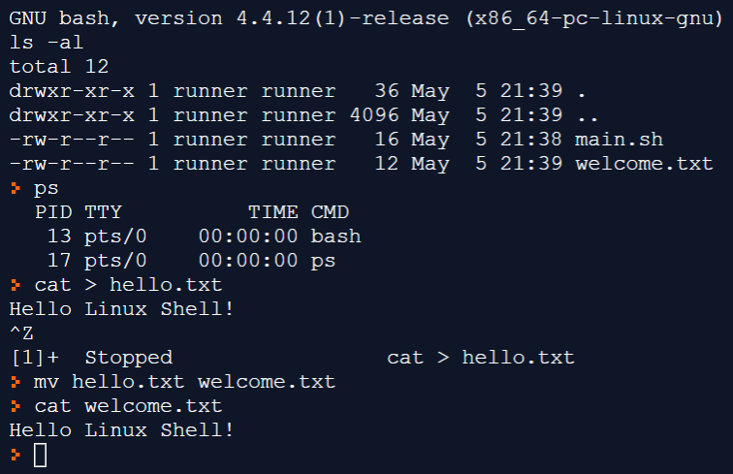
Operating Systems
Working with operating systems (Linux, Windows, others) is an important skill for software engineers
Installation, configuration and basic system administration
Process management, file system, users and permissions
Sample Linux shell commands:
Create a file:
Rename a file:
View file contents:
cat > hello.txt
mv hello.txt welcome.txt
cat welcome.txt

Slide 58
Linux Shell Commands
Live Demo
https://repl.it/@nakov/bash-shell-example

Slide 59
Internet of Things (IoT)

Slide 60
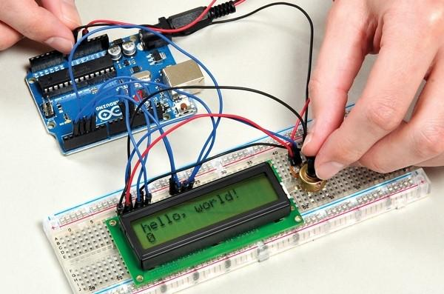
Embedded Systems and IoT
Embedded systems
Hardware + software, dedicated to certain task, e.g. control the lights or the heating at home
The hardware has limited resources (CPU, RAM, battery, …)
Internet-connected embedded systems are known as "Internet of Things" devices (IoT devices)

Slide 61

IoT Microcontrollers
Microcontrollers == microchip (CPU + RAM + GPIO) on a board
Examples: Arduino, ESP8266, ESP32, Micro:bit, ATmega328
IoT systems consist of microcontroller (or mini-computer) + peripheries + software + Internet connectivity + back-end
Peripherals: LED lights, buttons, sensors, buzzers, relays, displays
Back-end: cloud-based (e.g. Blynk, Thinger) or local (home computer)
Connectivity: WiFi, Bluetooth, LoRa, 4G LTE (with SIM card), 5G
Programming languages for IoT devices:
C, C++, JS / Python / C# (some devices)
61

Slide 62
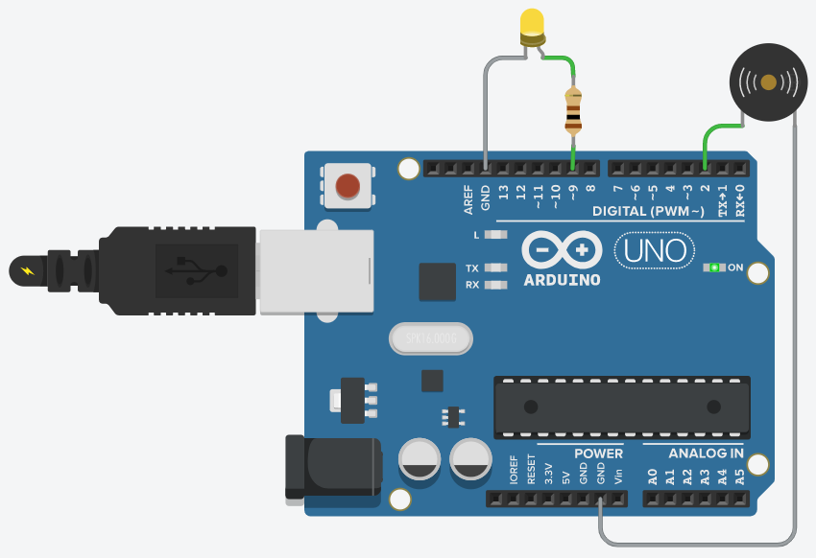
Microcontroller Arduino – Example
#define LED_PIN 9
#define BUZZER_PIN 2
void setup() {
pinMode(LED_PIN, OUTPUT);
}
void loop() {
int brightness = 0;
while (brightness <= 255) {
analogWrite(LED_PIN, brightness);
delay(15);
brightness += 3;
}
tone(BUZZER_PIN, 300, 100);
}
62

Slide 63
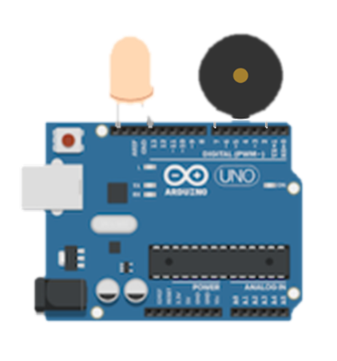
Arduino @ Tinkercad
Live Demo
https://www.tinkercad.com/things/hjgbxEoS5TX

Slide 64
Software Engineering

Slide 65
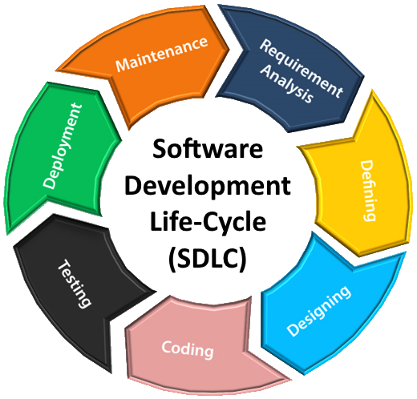
Software Development Lifecycle (SLDC)
Software engineering is not just coding!
The SDLC includes the following activities:
Requirements analysis
Software design
Construction
Testing
Development processes (Waterfall / Scrum / Kanban) define workflow and key practices
Software project management
Release
Maintenance

Slide 66

Software Quality Assurance (QA)
What is software quality assurance (QA)?
Ensures the software quality
Performed by the QA engineers
Two approaches:
Testing (manual and automated)
Code reviews and quality inspections
Goal: to find and report the defects (bugs)
Defect are tracked in an issue tracker

Slide 67

Issue Tracker
Live Demo
https://github.com/twbs/bootstrap/issues

Slide 68
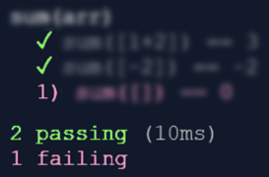
Unit Testing
Unit test == a piece of code that tests specific functionality in certain software component (unit)
function testSum() {
if (sum([1, 2]) != 3)
throw "1+2 != 3";
if (sum([-2]) != -2)
throw "-2 != -2";
if (sum([]) != 0)
throw "empty sum != 0";
}
function sum(arr) {
let sum = 0;
for (let item of arr)
sum += item;
return sum;
}

Slide 69
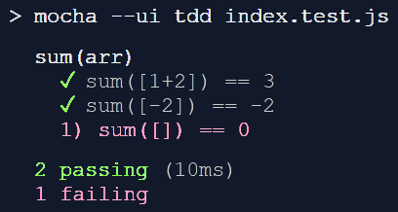

Unit Testing Framework
Unit testing frameworks simplify unit testing and reporting
Example: Mocha JS testing framework
const assert = require('assert');
suite('sum(arr)', function() {
test('sum([1+2]) == 3', function() {
assert.equal(sum([1, 2]), 3); });
test('sum([-2]) == -2', function() {
assert.equal(sum([-2]), -2); });
test('sum([]) == 0', function() {
assert.equal(sum([]), 0); });
});

Slide 70
Unit Testing with Mocha
Live Demo
https://repl.it/@nakov/mocha-unit-test-example-js

Slide 71



Source Control Systems
Source control systems keep the source code (+ other project assets) in a shared repository
Developers can clone a repository, pull the latest version, commit & push local changes, view the change logs, etc.
Git is the most popular source control system
Other version control systems: SVN, TFS, Perforce
GitHub is the #1 site for Git project hosting
Git hosting + issue tracker + project tracker + build system
71

Slide 72
GitHub – Example
Clone a repository from GitHub
Modify local files
Commit changes (local)
Push the changes to GitHub
git clone https://github.com/SoftUni/playground
notepad README.md
git add . & git commit -m "Added something"
git push

Slide 73

Git and GitHub
Live Demo
https://github.com/SoftUni/playground

Slide 74

Project Trackers and Kanban Boards
Project trackers organize and track project tasks
Tasks may have description, sub-tasks, assigned people, deadline
Kanban boards visualize the work on a project
Typical columns: Backlog, In Progress, Done
Examples: Trello, GitHub Projects
74

Slide 75

Trello Project Board
Live Demo
https://trello.com/b/HPpU2eCV/company-web-site

Slide 76

Summary
…
…
…
Front-end development concepts: front-end, UI concepts, DOM, AJAX, routing, templating, UI frameworks
Back-end development concepts, RESTful services, databases, ORM frameworks, MVC architecture, cloud, containers, Docker, …
Embedded systems and IoT, Arduino, ESP32
Software engineering, source control systems, QA, unit testing, Kanban, …
76

Slide 77
Questions?
Notes:
77

Slide 78
Trainings @ Software University (SoftUni)
Software University – High-Quality Education, Profession and Job for Software Developers
softuni.bg, softuni.org
Software University Foundation
softuni.foundation
Software University @ Facebook
facebook.com/SoftwareUniversity
Software University Forums
forum.softuni.bg
Notes:
78

Slide 79

License
This course (slides, examples, demos, exercises, homework, documents, videos and other assets) is copyrighted content
Unauthorized copy, reproduction or use is illegal
© SoftUni – https://softuni.org
© Software University – https://softuni.bg
Notes:
79

